Slide 1
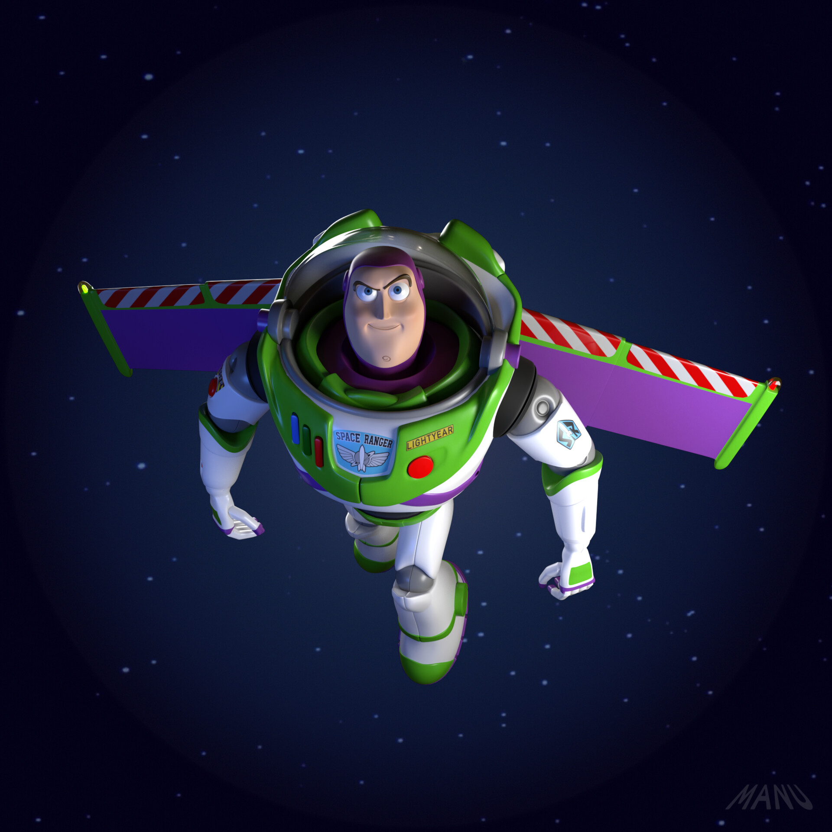
To infinity and beyond
Trying to indentify cestial objects and how far away they using AI

Slide 2
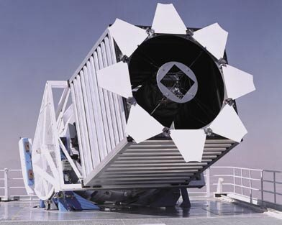
Goal(s) of the project
Use AI & Deep Learning to make it is easier to identify celestial objects using pictures and data collected by the Sloan Digital Sky Survey telescope located at Apache Point in New Mexico
Try to also predict the distance between these objects and us using “red shift”

Slide 3
Work done
Scrapping to retrieve pictures and celestial information from the SDSS web site
Data augmentation to get well balanced data
Training and evaluation of various models using CNN to reach a good enough accuracy
Packaging of code
Creation of simple web UI
Deployment in Container in GCP

Slide 4
Demo (if available)

Slide 5
Challenges

Slide 6
Lessons learned

